Slide 1
Gazebo
Robots in Context
Avgi Kollakidou avko@mmmi.sdu.dk
PhD Student
SDU Robotics, Maersk Mc-Kinney Moller Institute
October 2023

Slide 2
General
Tutorial links on bottom of each page
Commands indicated by: $ command
Each ROS command is launched in a new terminal
Variables that should be changed indicated by: <> ($ros2 topic echo <topic>)

Slide 3

Content
Gazebo
What is Gazebo?
Why Gazebo?
RViz vs Gazebo
Gazebo Elements
Transformations TF2
Universal Robot Description Format
Programming exercise

Slide 4
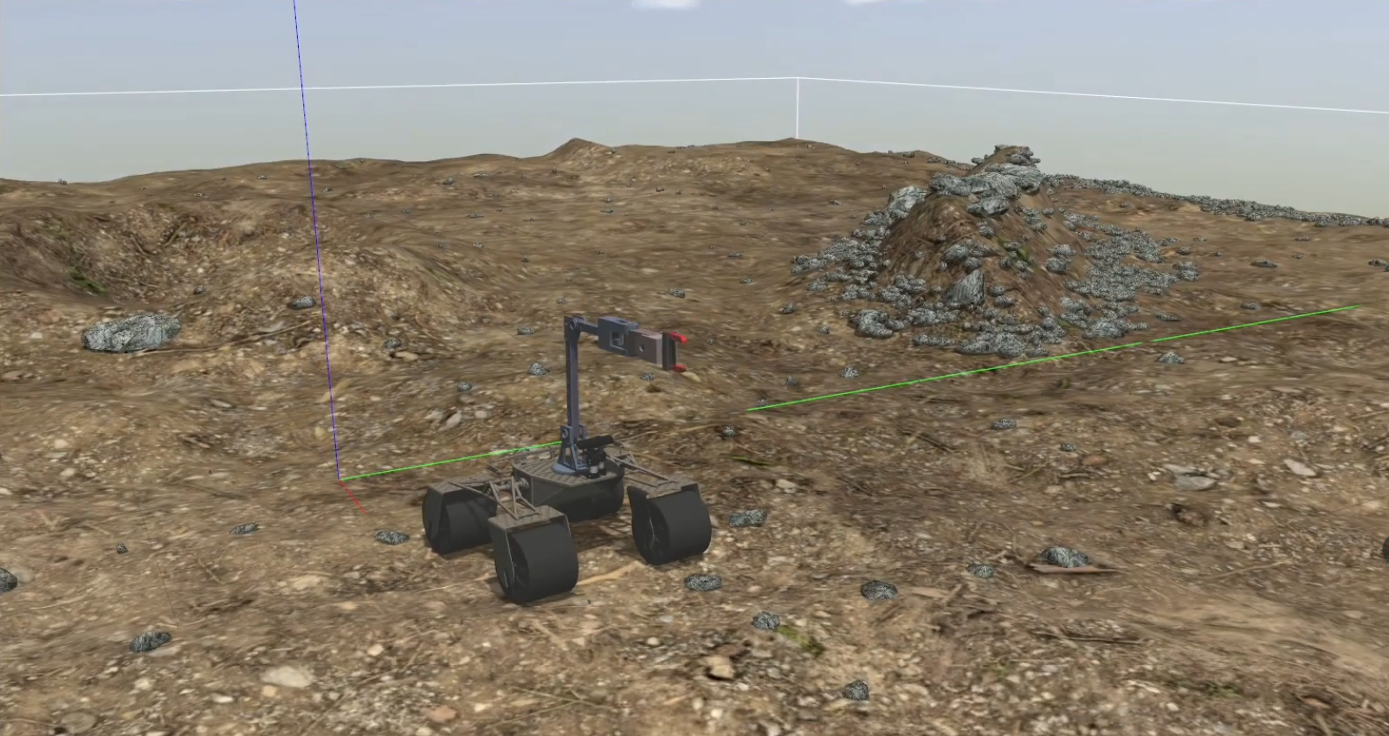
Gazebo

Slide 5
What is Gazebo?
Simulation engine
Realistic rendering of environments
Multiple physics engines
ODE – default [1]
Bullet [2]
Simbody [3]
DART [4]
​[1] Open Dynamics Engine - https://www.ode.org/​ [2] Bullet - https://pybullet.org/wordpress/
[3] Simbody - https://simtk.org/projects/simbody [4]Dynamic Anumation and Robotics Toolkit https://dartsim.github.io/

Slide 6
Why Simulation?
Save time
Hardware independent
Cheap failures

Slide 7
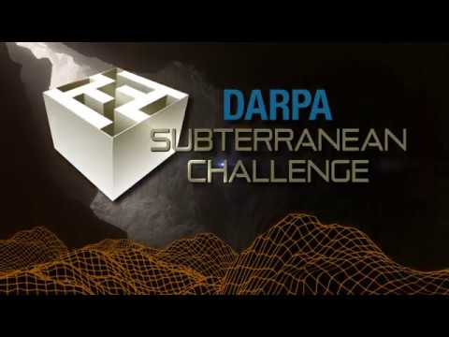
Why Gazebo?
3D physics and dynamics
Configurable
User interaction
Large community
robot models
sensors (noise)
ROS compatible

Slide 8
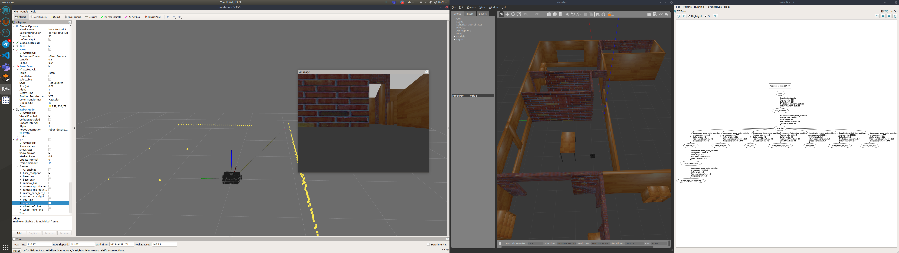
Gazebo vs RViz
Robot equipped with
camera
laser scanner
Simulate
environment
sensors
physics
Visualise
surroundings
sensor readings

Slide 9
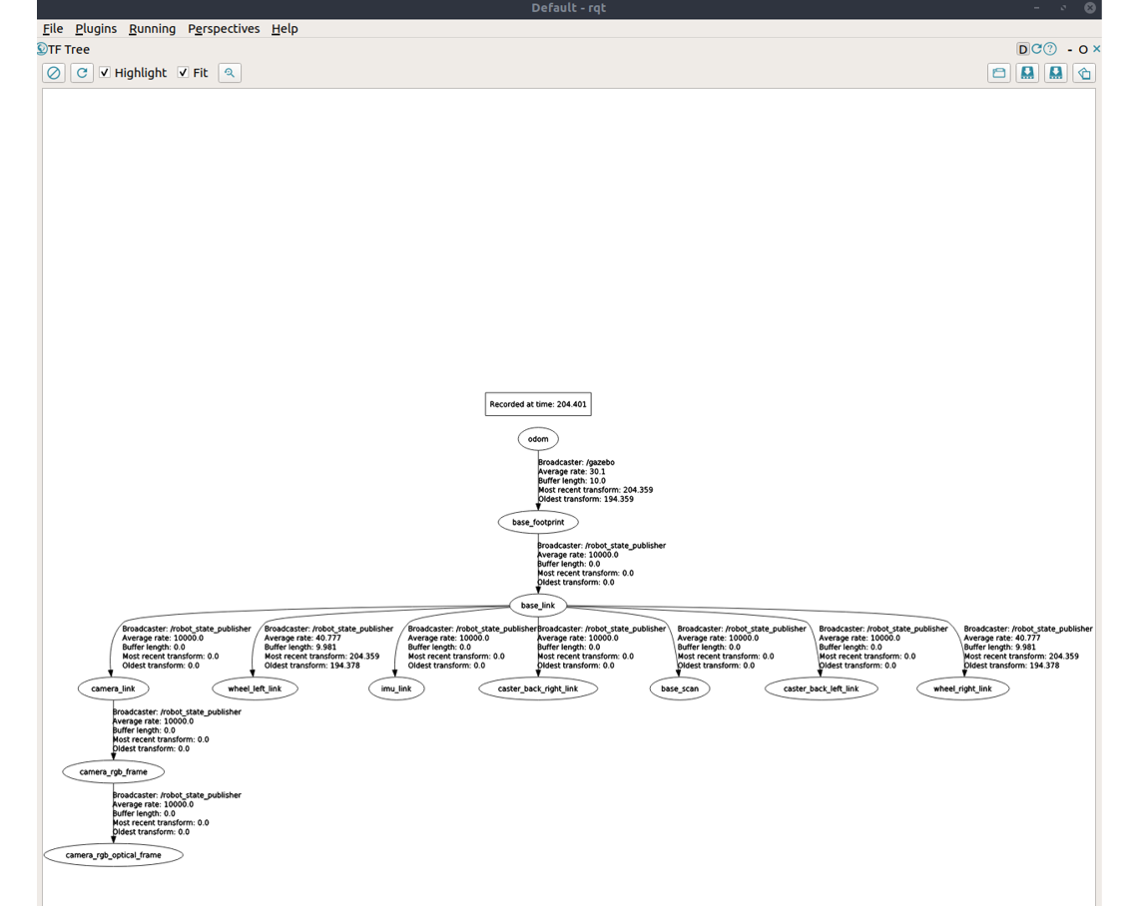
RViz vs Gazebo (vs rqt)
GUI for ROS
Transformation tree
Dynamic reconfigure
Topic graph
Image viewer

Slide 10
Gazebo Architecture
Server
simulating the physics, rendering, and sensors
Client
visualise and interact with simulation
https://classic.gazebosim.org/tutorials?tut=architecture&cat=get_started#Introduction

Slide 11
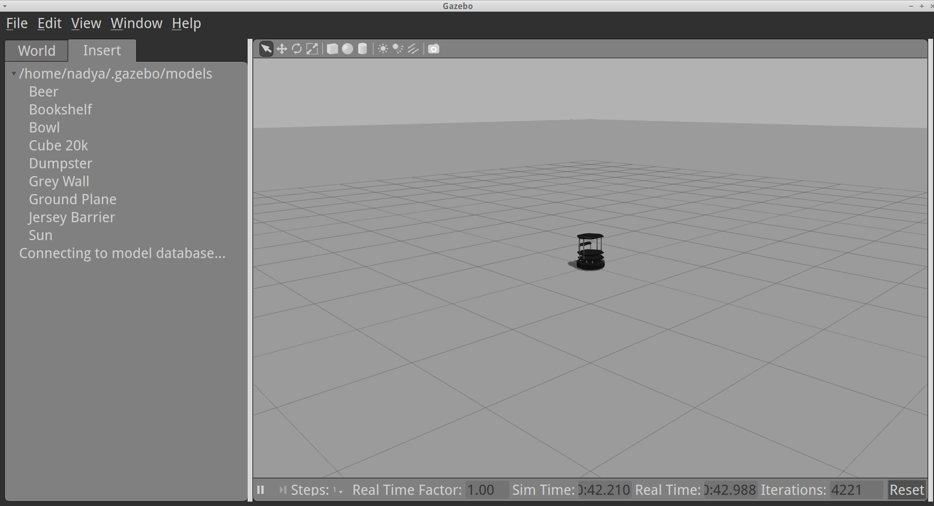
Launch Gazebo
Independent
$ gzserver
$ gzclient
$ gazebo
With ROS
$ ros2 run gazebo_ros gazebo
$ ros2 launch gazebo_ros <world_name>.launch
Empty world - turtlebot

Slide 12
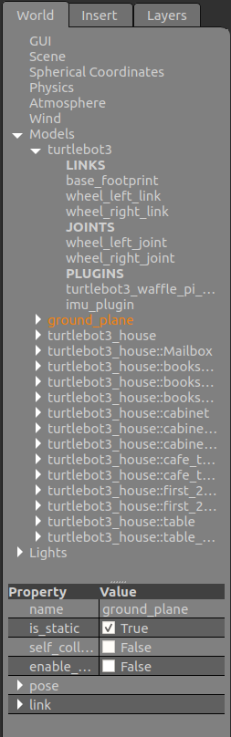
Gazebo Elements
Worlds
robots and objects (buildings, tables) & global parameters (sky, ambient light)
Models
links, joints, sensors, plugins
Links
visual objects -- define visual representation
collision objects -- define colliding surface
Joints
Sensors
Plugins
Notes:
All collections of something
World – collection of robots
Model – collection of links ...

Slide 13
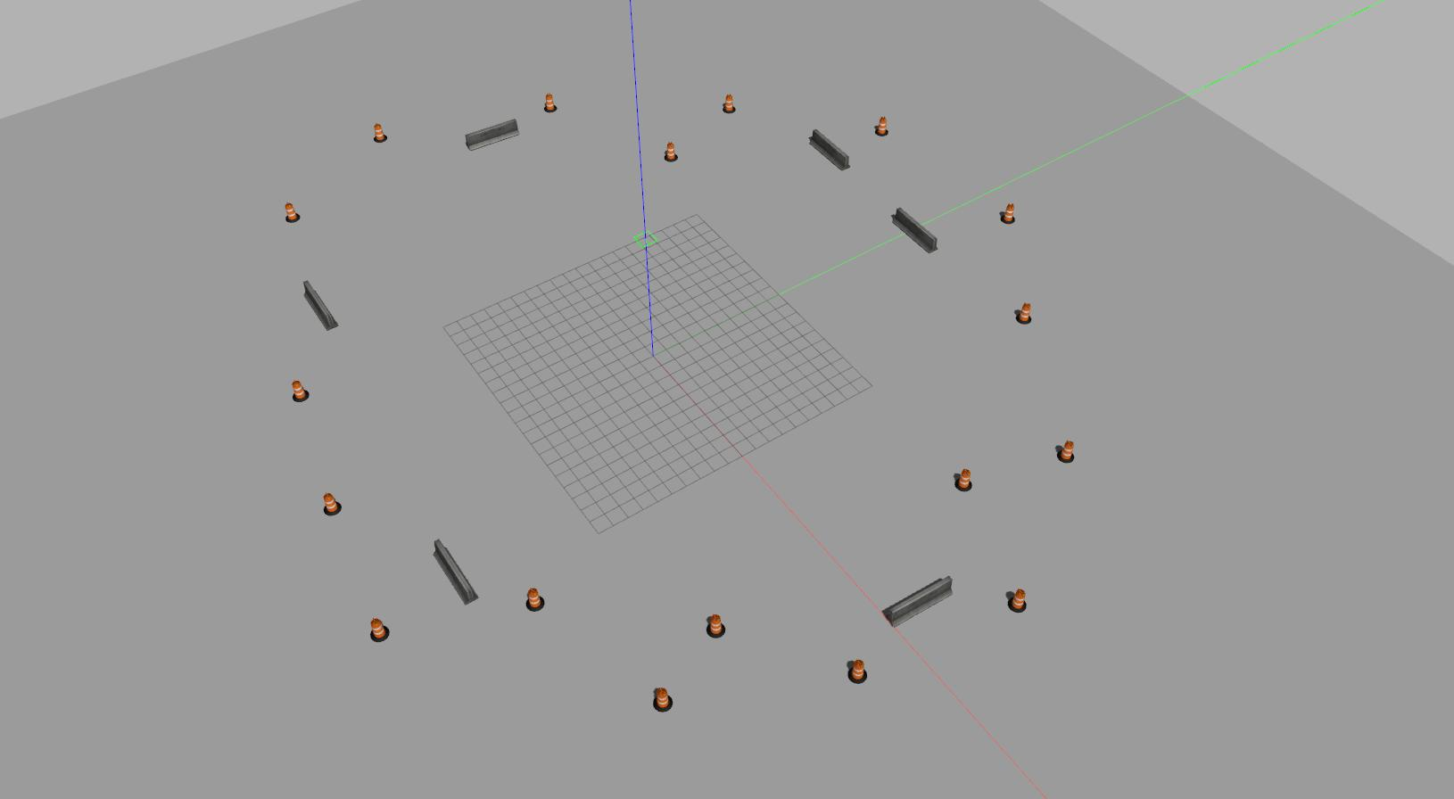
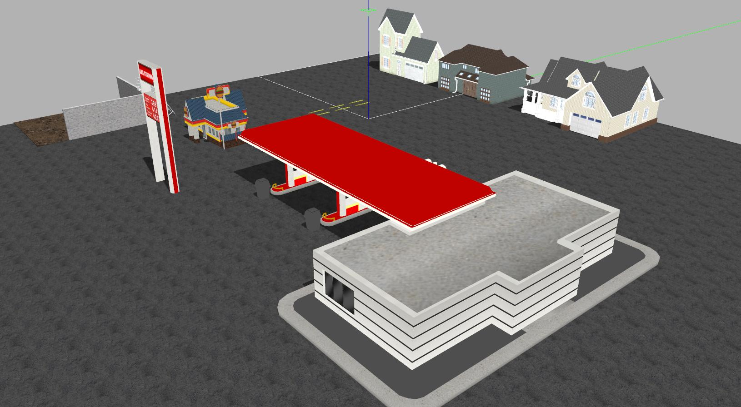
Worlds
Collection of models
Launched by gzserver
'.world' file
URDF (Unified Robot Description Format)
SDF (Simulation Description Format)
Collection of worlds - https://github.com/chaolmu/gazebo_models_worlds_collection
Gazebo world tutorial - https://classic.gazebosim.org/tutorials?tut=build_world&ver=1.9

Slide 14
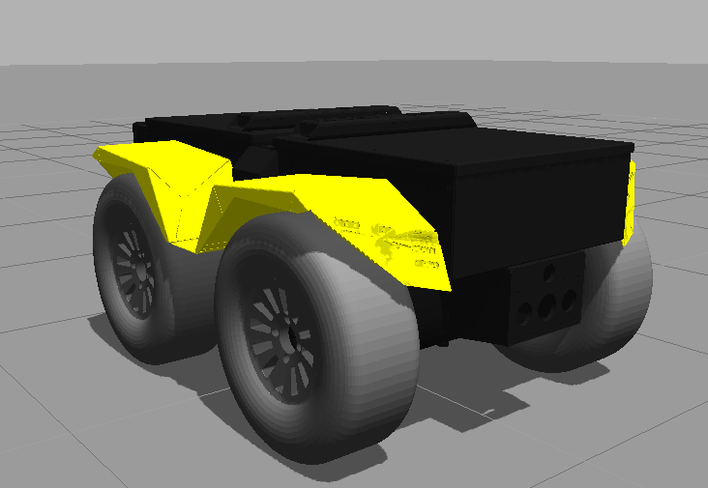
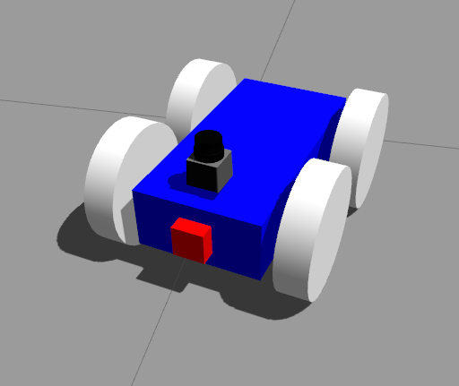
Models
Physical properties:
Body – simple shapes
Kinematics
Dynamics
Appearance
Interface
Husky - Clearpath
Simple robot – bunchOfCoders
Collection of models - https://github.com/osrf/gazebo_models
Gazebo model tutorial - https://classic.gazebosim.org/tutorials?tut=build_model&cat=build_robot
Notes:
Kinematics: joints, velocities
Dynamics: mas, friction, forces

Slide 15
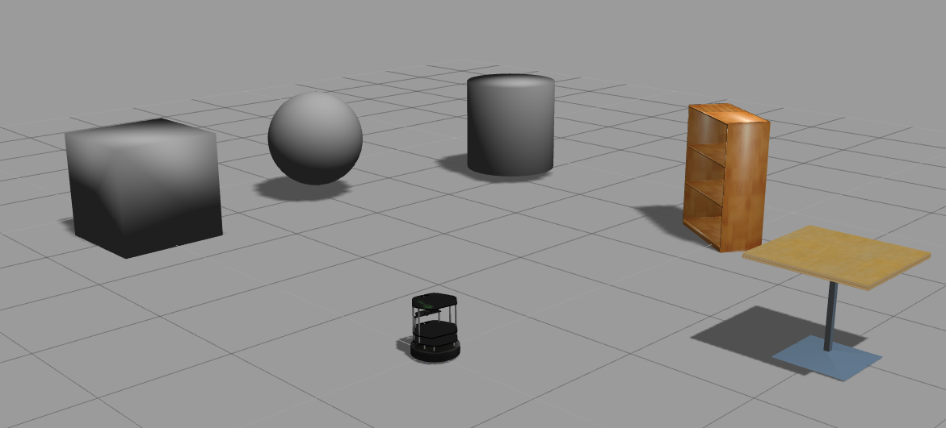
Links
Physical properties:
Body – simple shapes
Kinematics
Dynamics
Appearance
Interface
Notes:
Kinematics: joints, velocities
Dynamics: mas, friction, forces
Interface for control

Slide 16
Joints
URDF
Revolute -- hinge joint, limited range
Continuous -- hinge joint, no limits
Prismatic -- sliding joint, limited range
Fixed -- all degrees of freedom locked
Floating -- allows motion for all 6 DOF
Planar -- allows motion
URDF links - https://wiki.ros.org/urdf/XML/joint
SDF links - http://sdformat.org/spec?ver=1.9&elem=joint#joint_type
Notes:
Kinematics: joints, velocities
Dynamics: mas, friction, forces
Interface for control

Slide 17
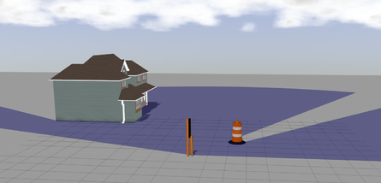
Sensors
Contact
Camera
GPS
IMU
Ray (range data)
...
Notes:
Kinematics: joints, velocities
Dynamics: mas, friction, forces
Interface for control

Slide 18
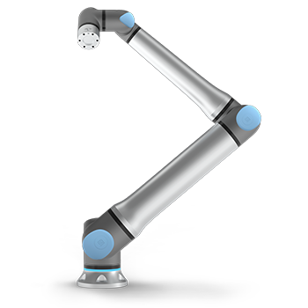

Links & Joints

Slide 19
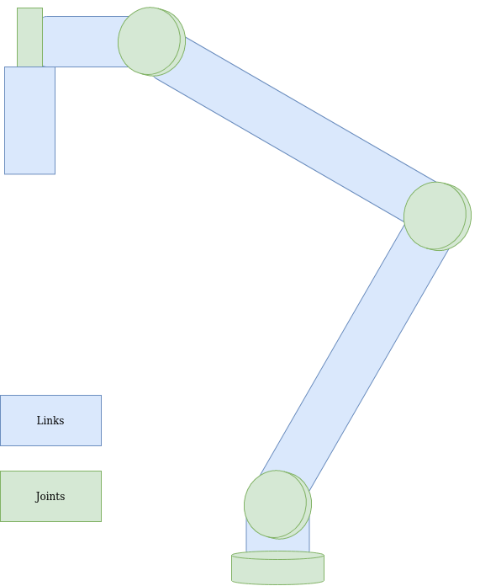
Links & Joints

Slide 20
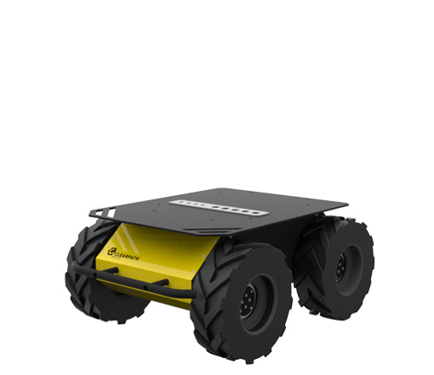
Links & Joints

Slide 21
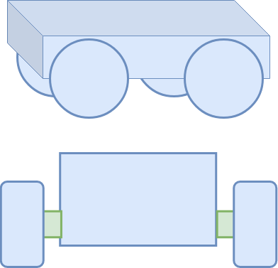
Links & Joints

Slide 22
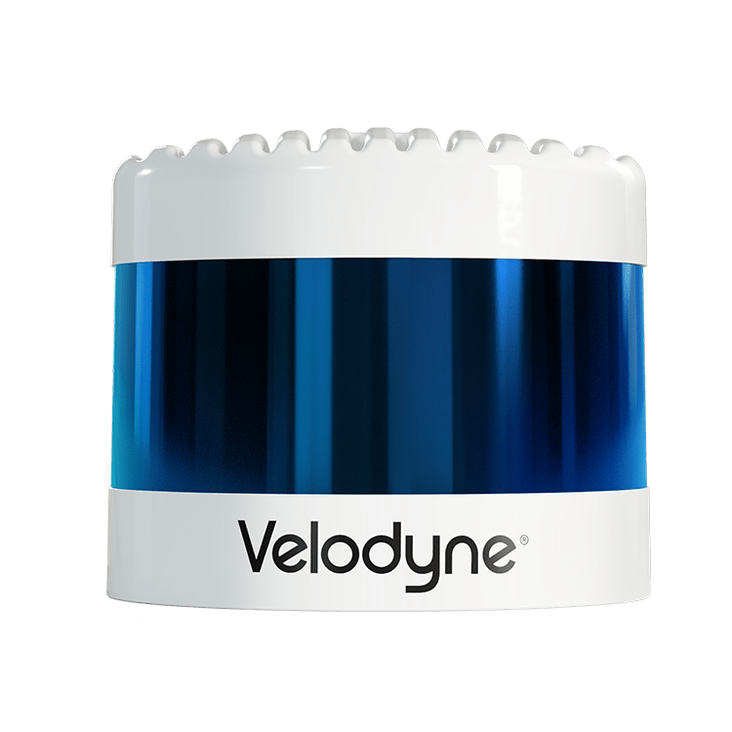
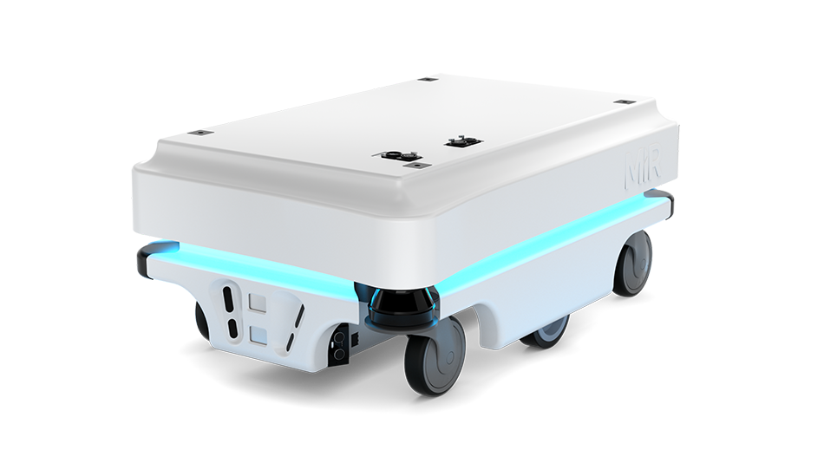
Links & Joints

Slide 23
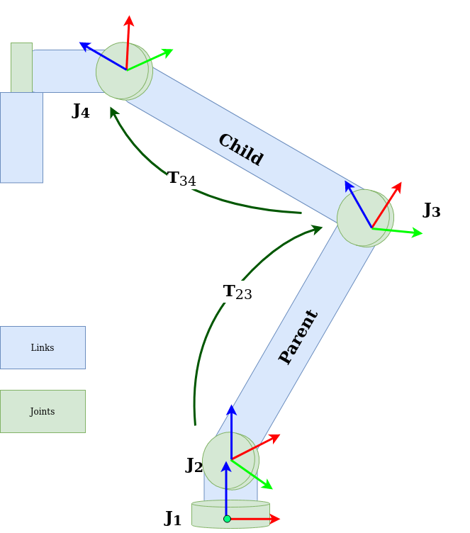
Frames & Transforms

Slide 24
TF2

Slide 25
TF2
Static transforms:
Wheel – base
Camera – base
End-effector – link

Slide 26
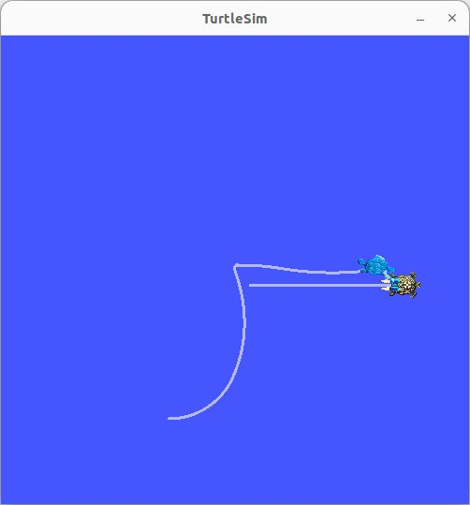
TF2

Slide 27
TF2
View TF frames information
$ ros2 run tf2_tools view_frames
Real time information
$ ros2 run tf2_ros tf2_echo [source_frame] [target_frame]
Play data:
$ros2 bag play <bag_name>
The data can then be viewed in Rviz

Slide 28
TF2
Frames for:
Object detection with laser scanner?
People tracking from camera?

Slide 29
URDF

Slide 30
URDF
XML
Textual CAD
Description of shapes, locations and connections of parts
Used by:
RViz – visualise robot
Gazebo – simulate robot
Navigation Stack – move around properly
https://industrial-training-master.readthedocs.io/en/melodic/_source/session3/Intro-to-URDF.html
http://wiki.ros.org/urdf/Tutorials/Building%20a%20Visual%20Robot%20Model%20with%20URDF%20from%20Scratch

Slide 31
URDF vs SDF
URDF
SDF
ROS compatible
Simple model descriptions
robots
sensors
Gazebo compatible
Extra features
World description
URDF --> SDF compatibility

Slide 32
Main elements
Link – rigid body
Joint – connection of 2 links

Slide 33
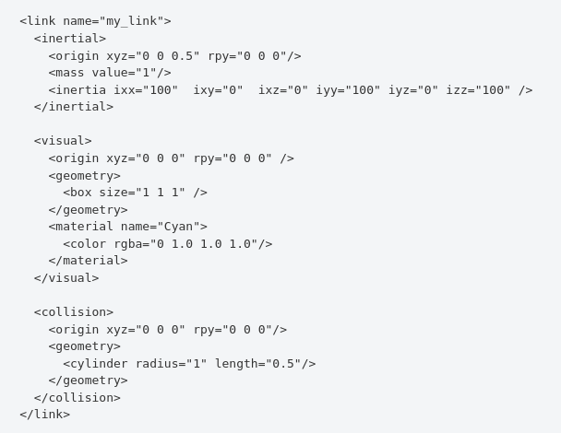
Links
Visual
name
Collision
geometry
origin
geometry
origin
Material
Inertial
origin
mass
inertia
https://wiki.ros.org/urdf/XML/link

Slide 34
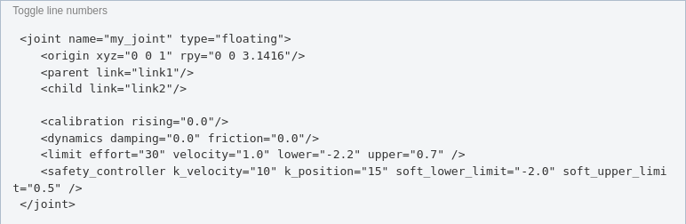
Joints
Attributes
name
type
Elements
parent
child
limit (prismatic/revolute)
origin
axis
calibration
dynamics
mimic
safety_controller
https://wiki.ros.org/urdf/XML/joint

Slide 35
Links - Geometry
Shape | Declaration
Cylinder | <cylinder length="" radius=""/>
Box | <box size="x y z"/>
Sphere | <sphere radius=""/>
Mesh | <mesh filename=""/>

Slide 36
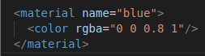
Links Material & Origin
MATERIAL
<material name="">
<color rgba="R G B α"/>
(Values between [0 1])
</material>
<material name="">
<texture filename=""/>
</material>
ORIGIN
<origin rpy="r p y" xyz="x y z"/>
rpy: roll, pitch and yaw of fixed axis in radians.
xyz: location offset
(defaults to identity if not specified)

Slide 37
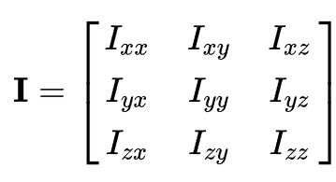
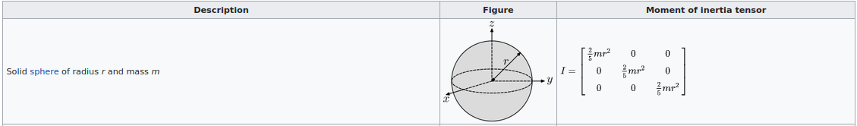
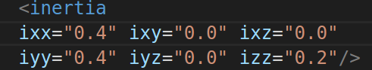
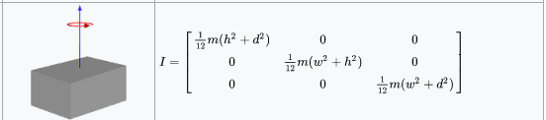
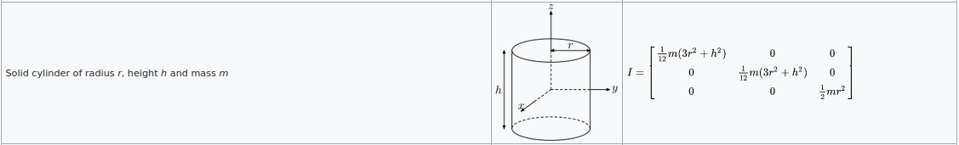
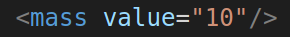
Links Inertia & Mass
Inertia
<inertia ixx="" ixy="" ixz="" iyy="" iyz="" izz="" />
Mass
<mass value=""/> (kg)

Slide 38
Joints
<parent link=""/> <child link=""/>
<limit
effort="" velocity="" lower="" upper="" />
Effort: N or N/m
Velocity: m/s or rad/s
<axis xyz=""/>
Axis of rotation or translation
<dynamics damping="" friction=""/>
+more

Slide 39
Visual vs Collision
Visual
Collision
More complex
Include meshes
Colours
Materials
No effect on physical properties!
Simple shapes
Collision detection computationally simpler
Define safety zones
Slightly larger areas for avoiding contact

Slide 40
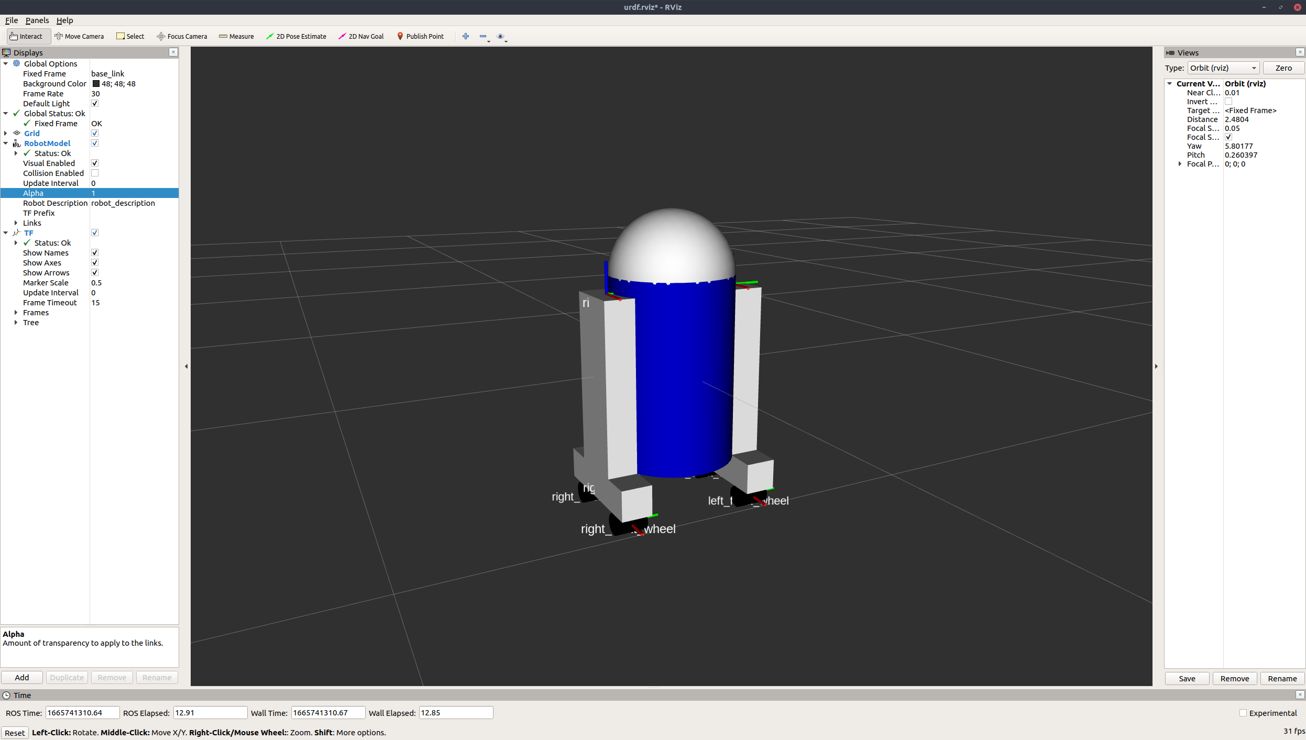
Make a robot model

Slide 41
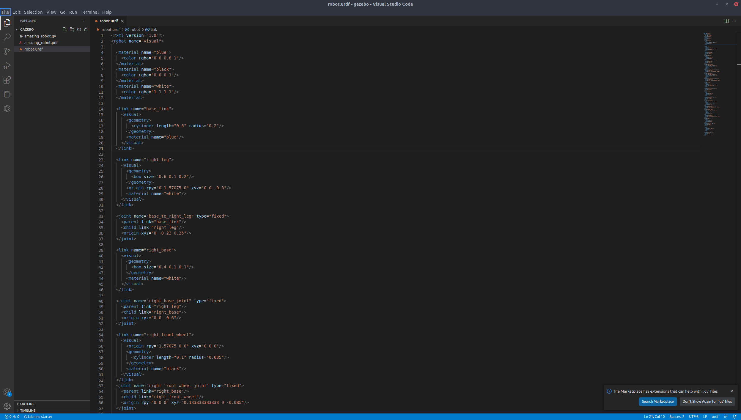
Links
Body – cylinder
Right Leg - box
Left Leg - box

Slide 42
Examine your URDF file
Syntax check
$ check_urdf <filename>.urdf
Graphical representation of link structure
$ urdf_to_graphiz <filename>.urdf
View in RViz
$ roslaunch urdf_tutorial display.launch model:=<filename>.urdf
requires: $ sudo apt-get install ros-humble-urdf-tutorial

Slide 43
Programming Exercise
Version 1 – mobile robot
Model a mobile robot using URDF (differential drive suggested)
Visualise in RViz
Spawn model in Gazebo
Mount camera or laser scanner on robot
Visualise sensor data

Slide 44
Programming Exercise
Version 2 – manipulator
Model a manipulator arm using URDF (minimum 2 joints)
Visualise in RViz
Spawn model in Gazebo
Mount camera on robot end-effector
Visualise sensor data

Slide 45
PRACTICAL

Slide 46
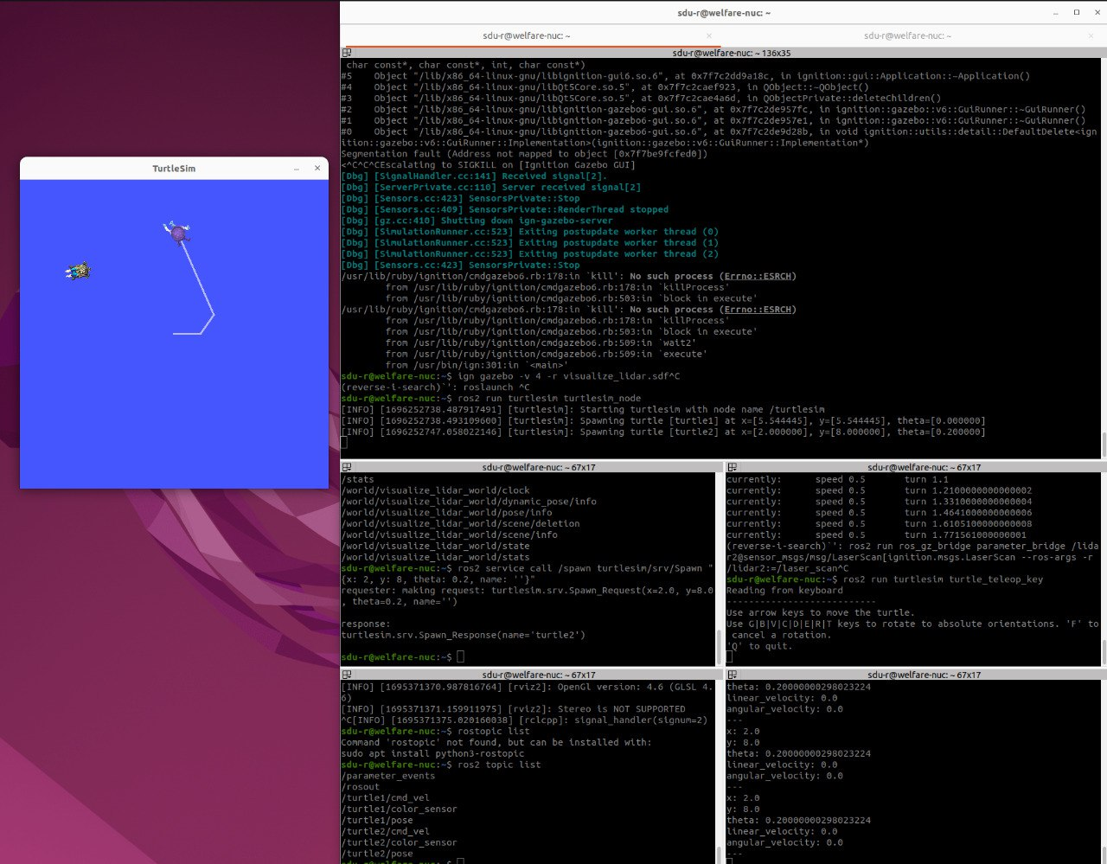
Terminator
$ sudo apt-get install terminator

Slide 47
ROSBAG

Slide 48
Rosbags
Simple recordings of sensor data
Easy way into understanding ROS, topics and messages
Replay your experiments
Find issues
Review data
Share data

Slide 49
Commands
Record data:
$ros2 bag record <topic_name1> <topic_name2>
View data info:
$ros2 bag info <bag_name>
Play data:
$ros2 bag play <bag_name>
The data can then be viewed in Rviz

Slide 50
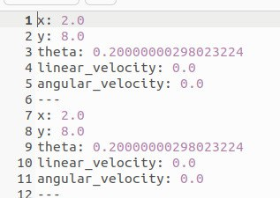
Export rosbag data
$ros2 bag play <bag_name>
$ros2 topic echo <topic_name> > data.csv

Slide 51
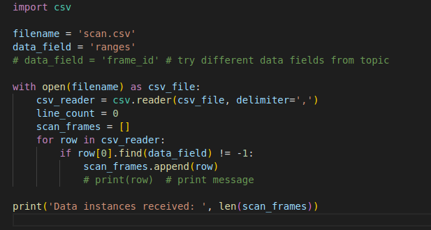
Read data with Python (or any other language)

Slide 52
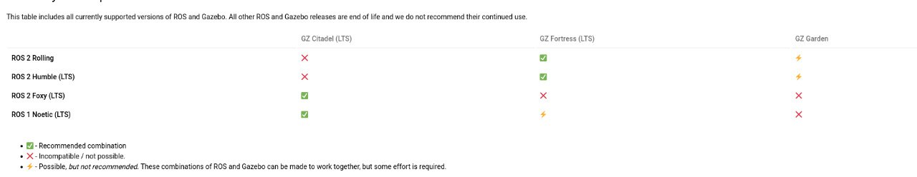
Download Gazebo
We will use Gazebo Fortress
$ sudo apt-get install ros-humble-ros-gz

